Slide 1
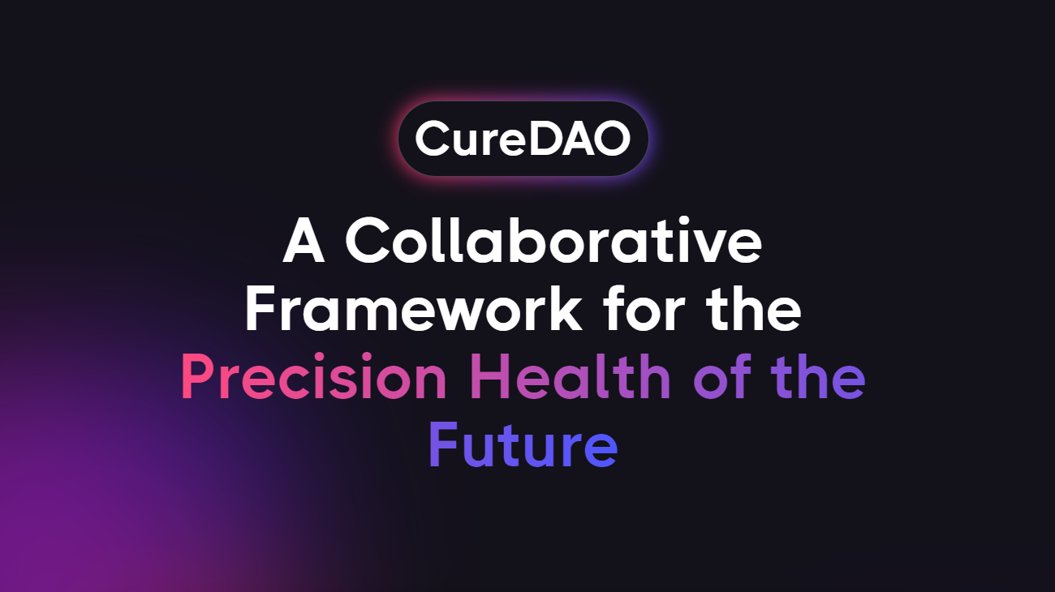
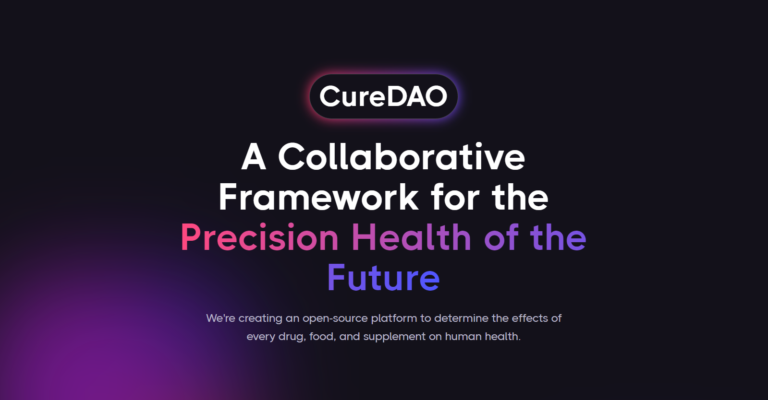
Notes:
We're creating an open-source platform to determine the effects of every drug, food, and supplement on human health.

Slide 2


2 billion people suffer from inflammation-mediated diseases influenced by hundreds of unknown factors.

Slide 3
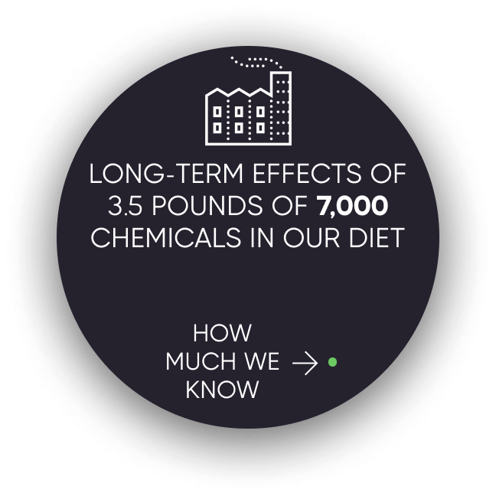
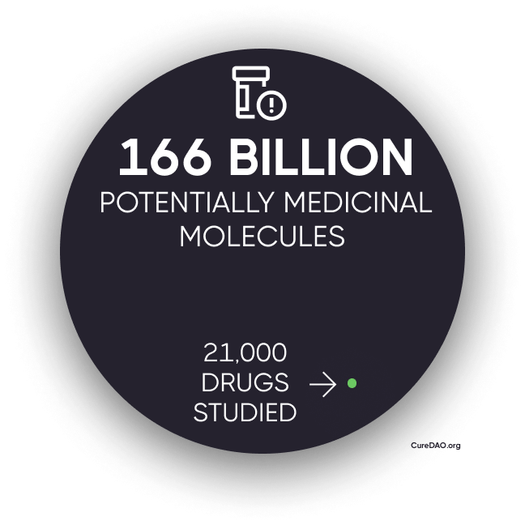
Due to the cost of research, we know almost nothing about anything that isn’t patentable.

Slide 4
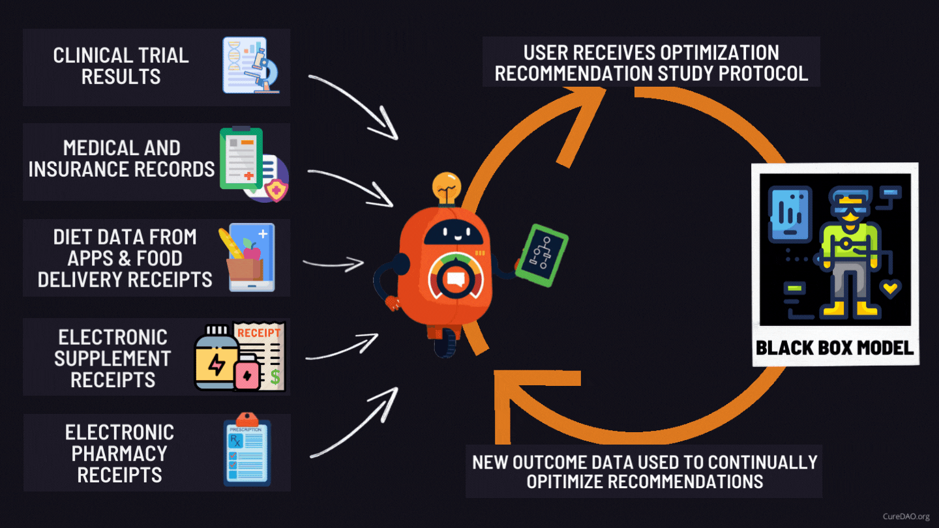
Solution: Turn Oceans of Human Generated Data into Personalized Recommended Daily Allowances

Slide 5

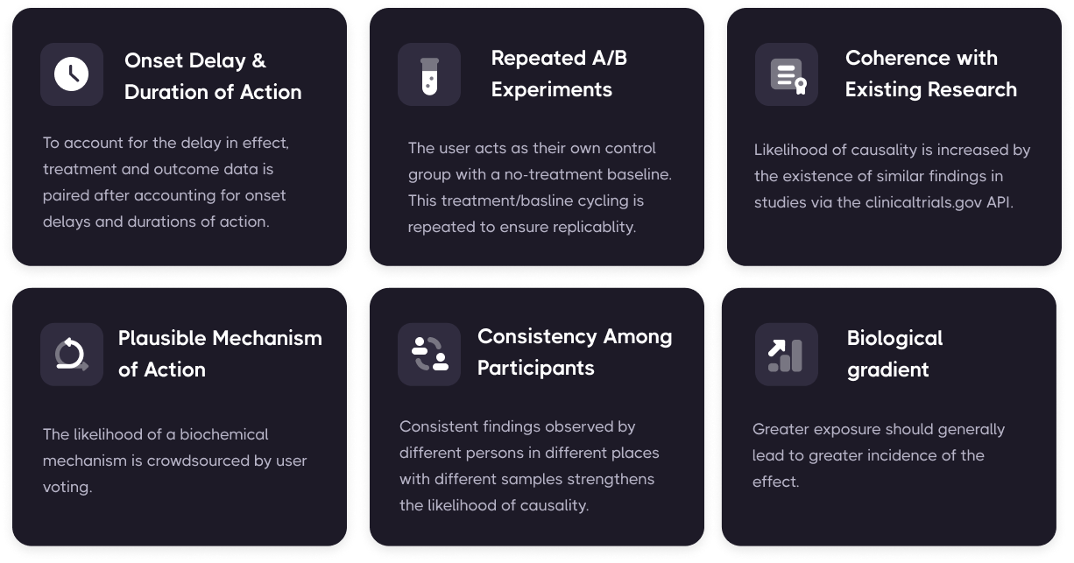
Overcoming Challenges with Real-World Evidence and Inferring Causal Relationships
Predictive control model machine learning algorithms can systematically determine optimal treatment dosages based on measurements obtained under real-life conditions involving noise, disturbances, and uncertainty.

Slide 6
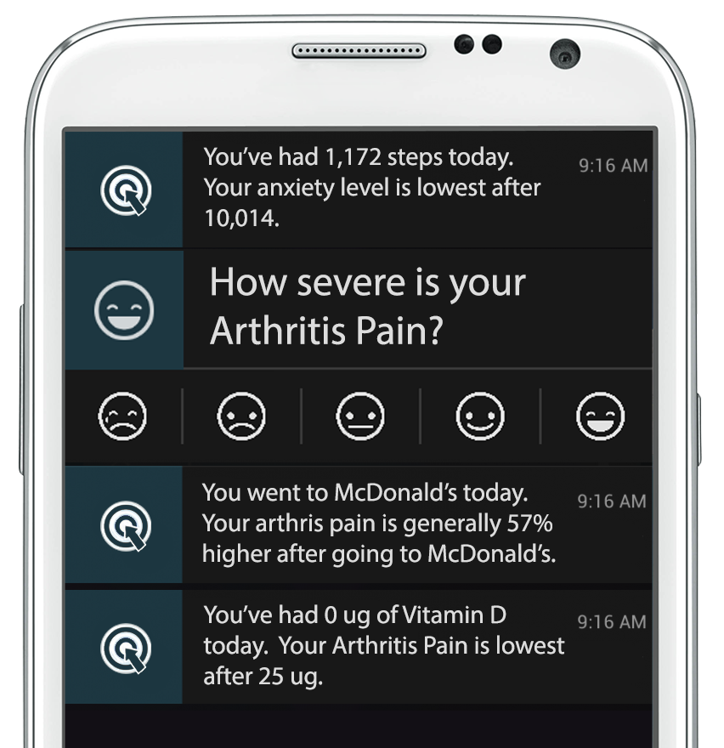
This enables Decision-Support Notifications with the most effective thing, you can do to minimize symptom severity

Slide 7
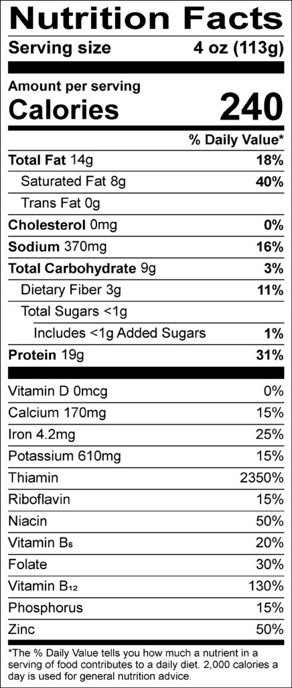
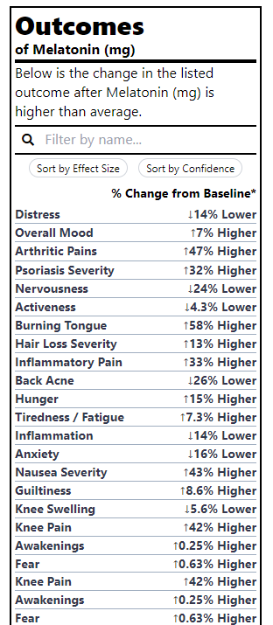
Outcome Labels
We’ve generated thousands of
because it’s more valuable to know the health effects of different foods and treatments than the amount of riboflavin

Slide 8

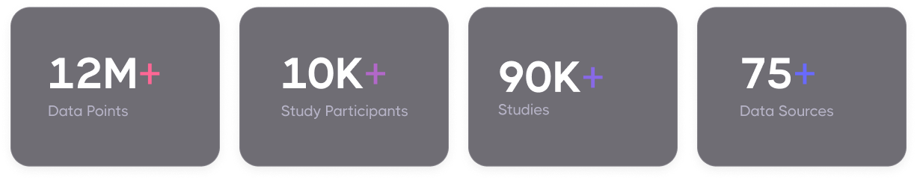

Slide 9


Unfortunately, most individual studies between a particular treatment and outcome only have a few participants.
We need more input.

Slide 10
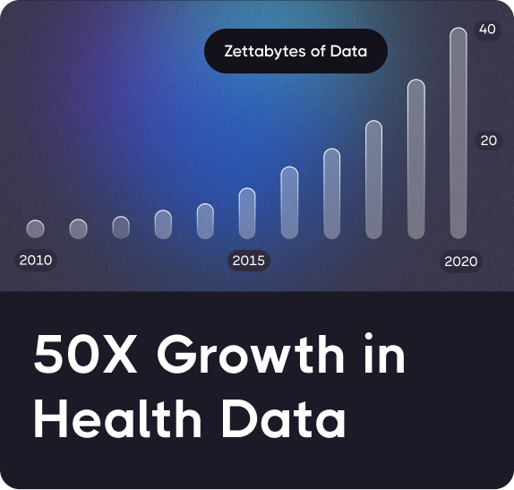
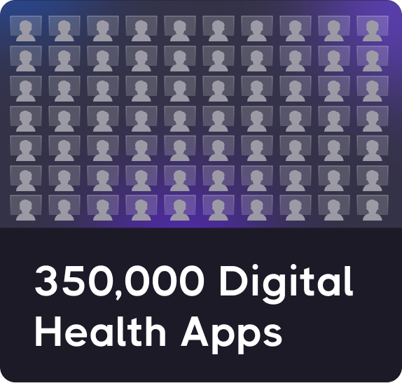
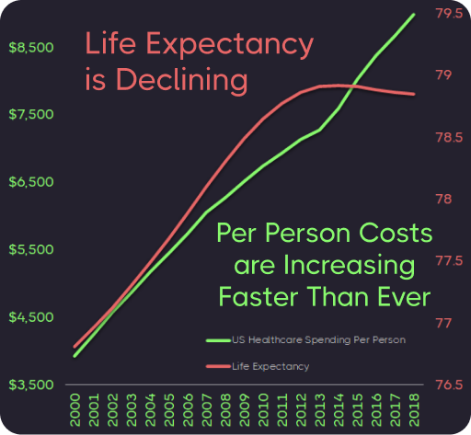
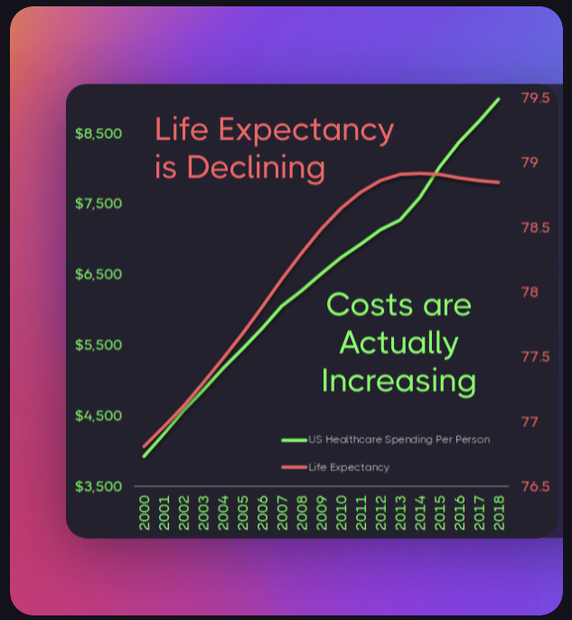
Question: How can an unprecedented explosion in health data and innovation produce no measurable improvement?
+
=

Slide 11
Answer: Collaboration & Data Sharing
is Punished by the Market
We’re wasting $157 billion paying over 350,000 programmers to write the same code to implement the same basic functionality.
Horizontal Stagnation
Notes:
The free-rider problem and the tragedy of the commons punishes any individual company that open sources it’s code

Slide 12
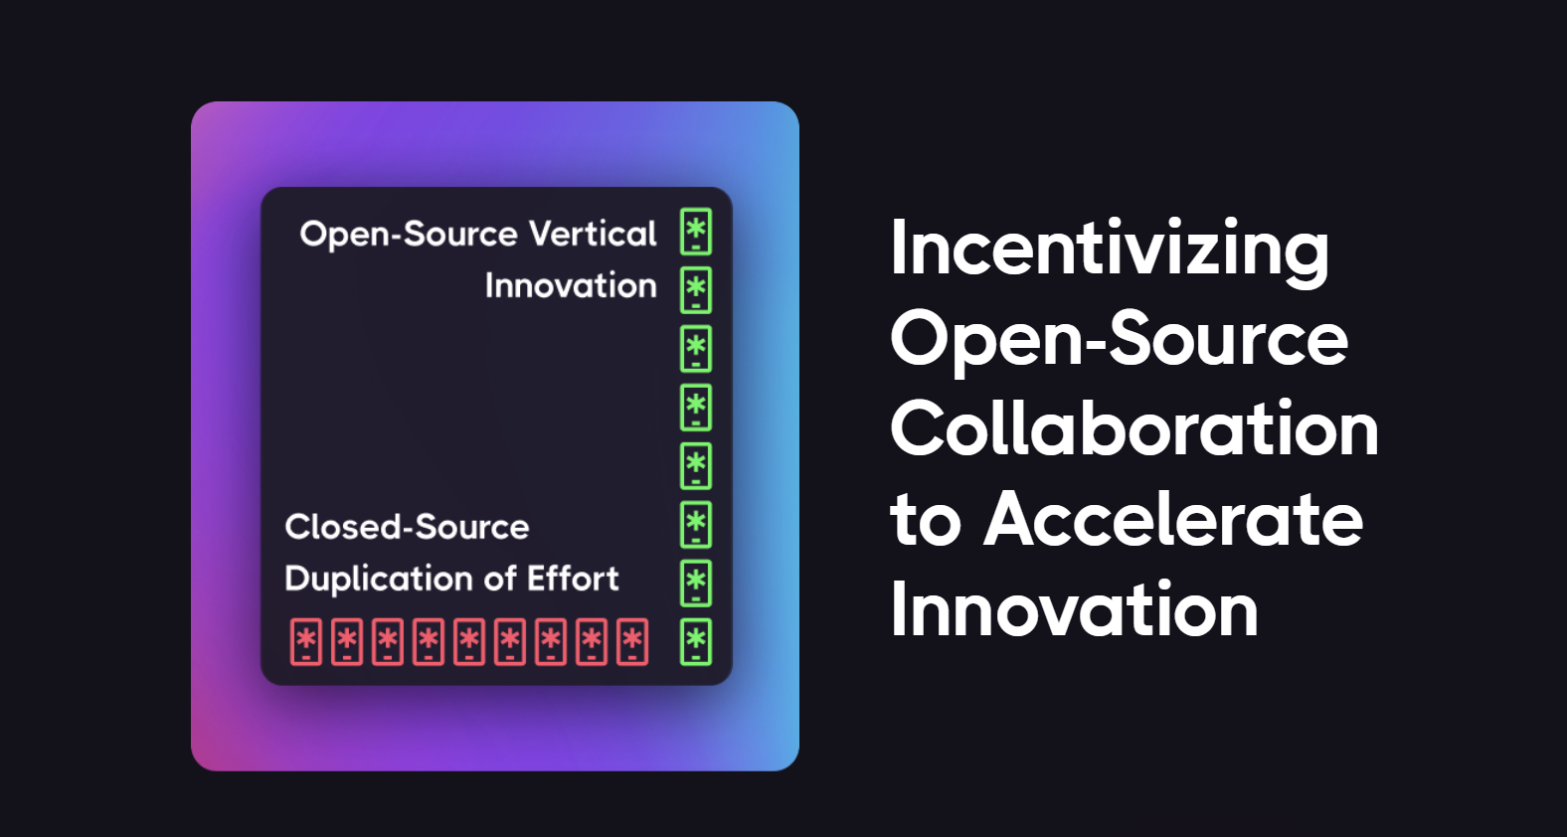
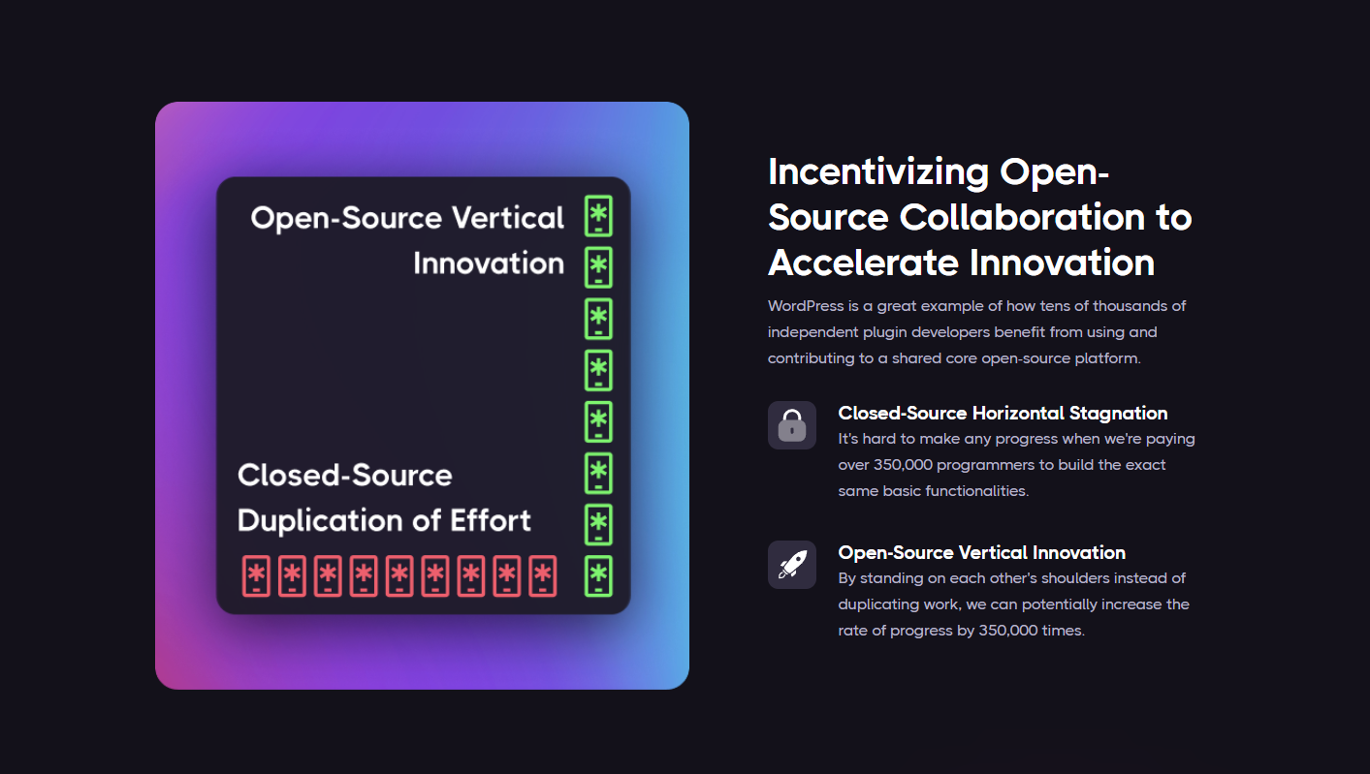
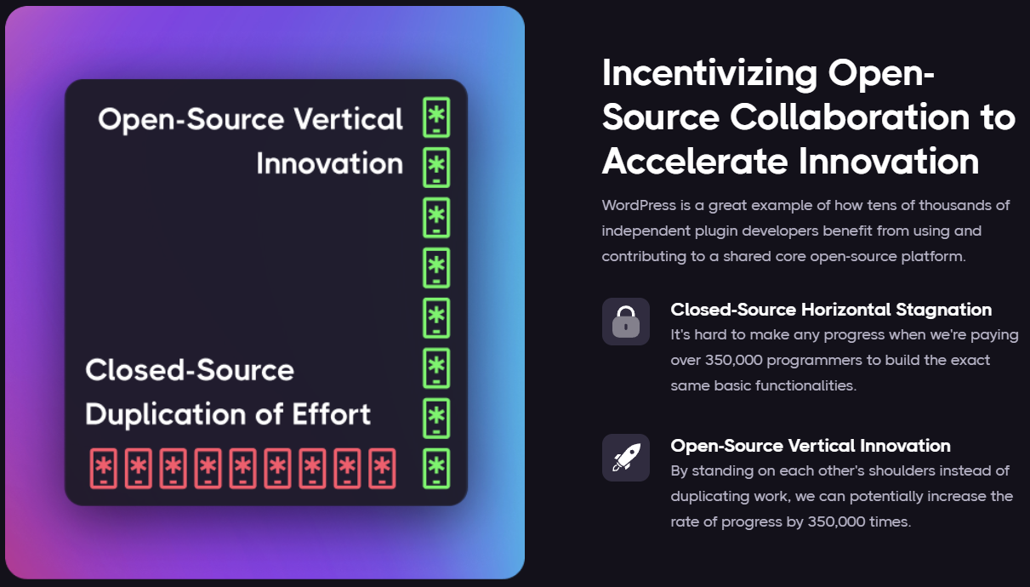
Notes:
It's hard to make any progress when we're paying over 350,000 programmers to build the exact same basic functionalities.
By standing on each other's shoulders instead of duplicating work, we can potentially increase the rate of progress by 350,000 times.
WordPress is a great example of how tens of thousands of independent plugin developers benefit from using and contributing to a shared core open-source platform.

Slide 13
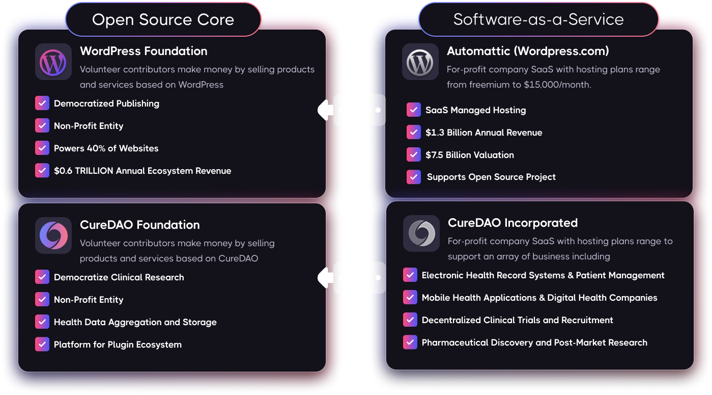
WordPress: A Model for Open-Source Success

Slide 14

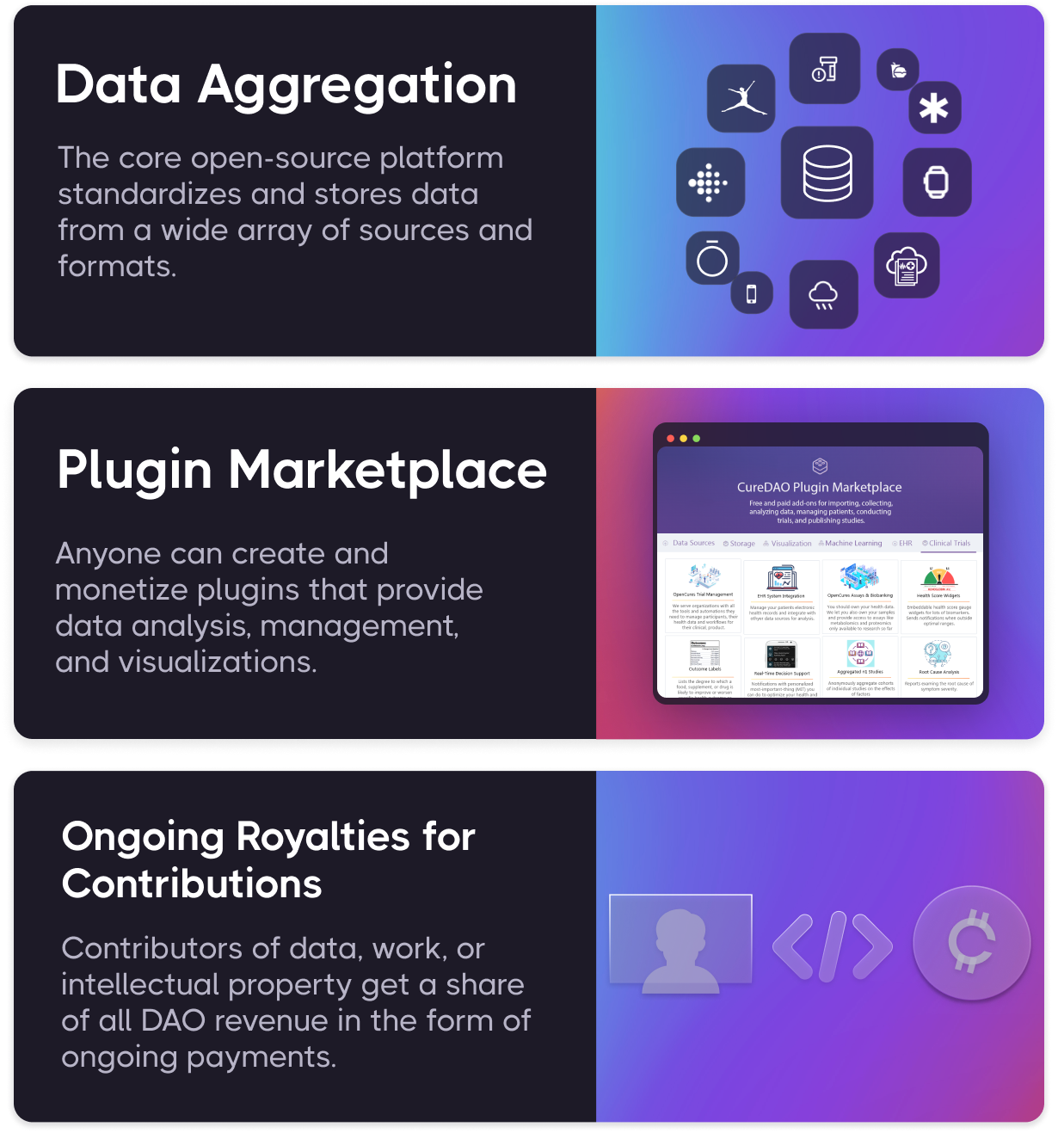
How it Works
CureDAO utilizes the power of Intelligent Voluntary Cooperation and new technologies to drive down the cost of clinical research.

Slide 15
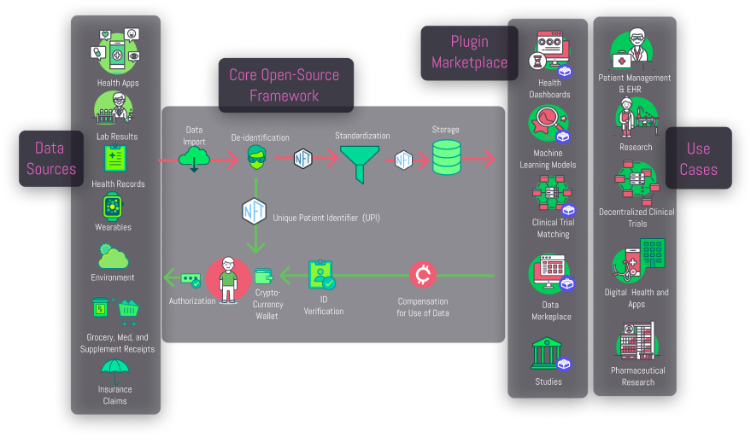

Slide 16
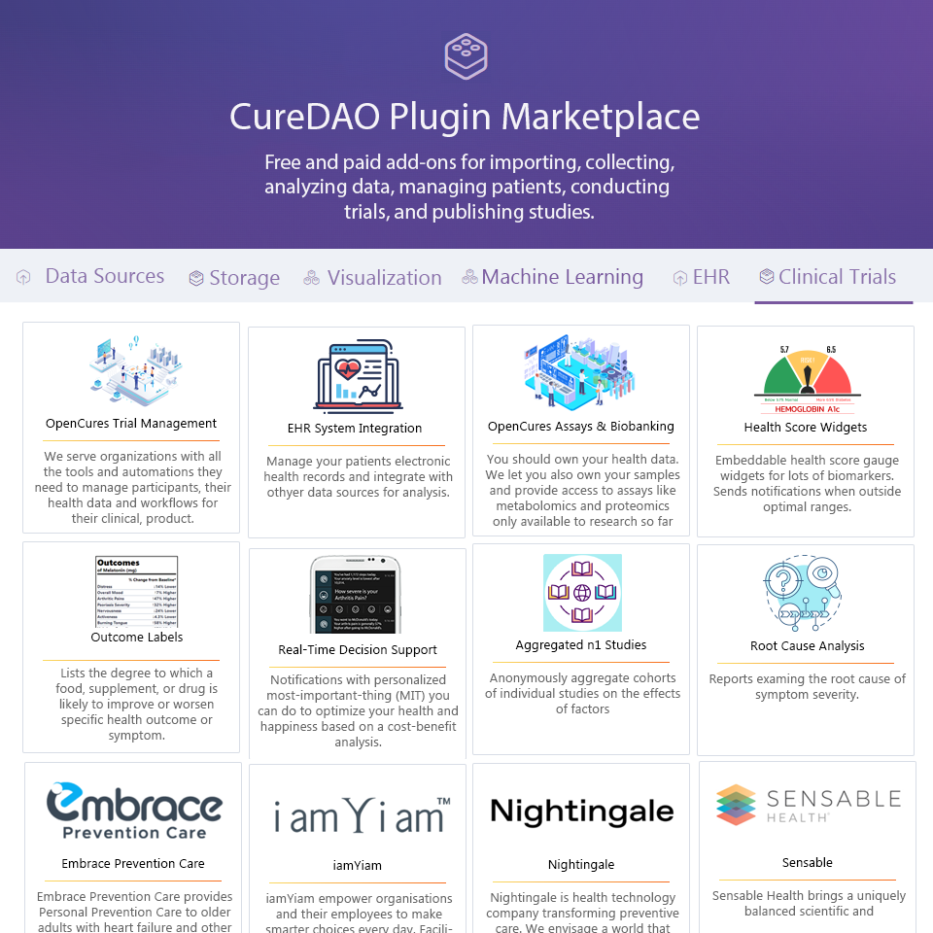

Slide 17


Data Collection Plugins
Back-end-
as-a-Service (BaaS) Functionality for Data Collection Apps
Notes:
First we developed mobile apps and browser extensions to make it incredibly easy to track your symptom severity in a fraction of a second using a unique popup interface.
Move circle
Remove browser
Screenshot of mood tracking screen

Slide 18
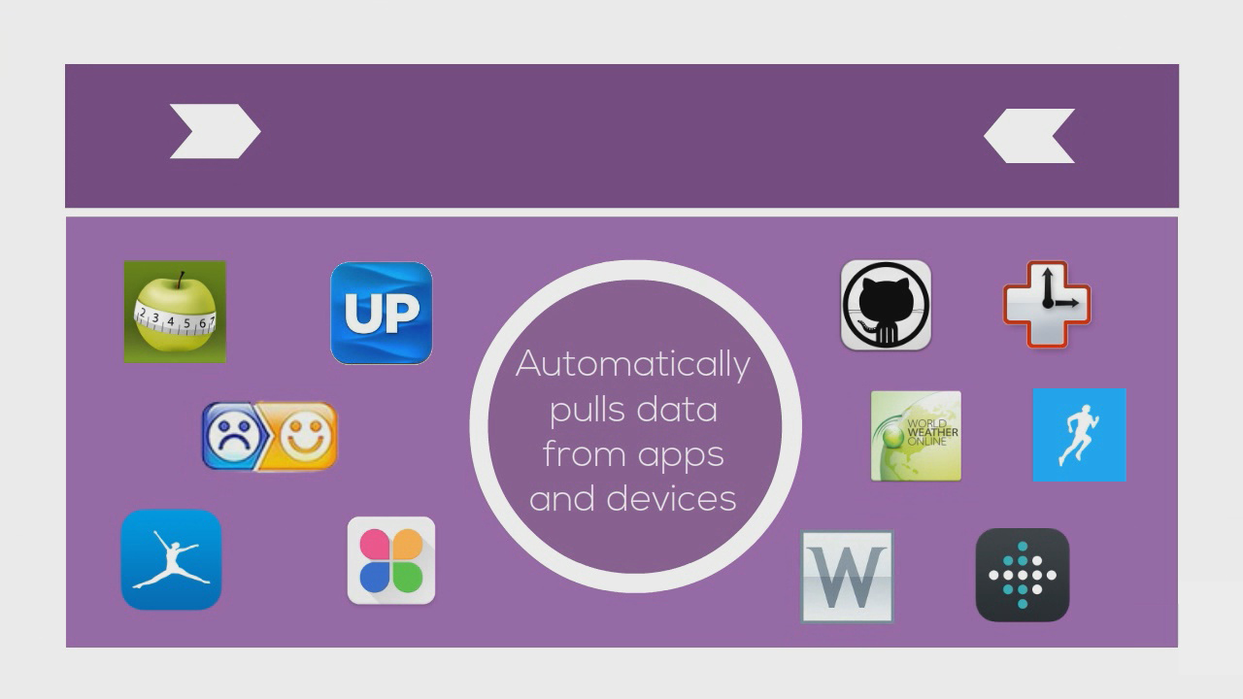

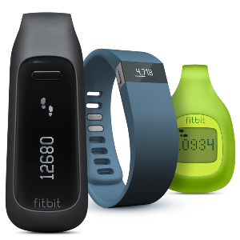


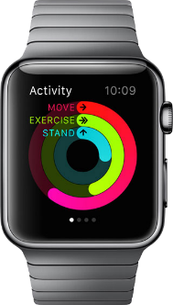

Importer Plugins
Notes:
Move information to left and images on the right.
We also built the QuantiModo Connector Framework, which enabled us to automatically pull passively or actively generated user data from dozens of applications and devices such as Fitbits, Withings scales and blood pressure monitors, and diet data from apps like MyFitnes
The QuantiModo Connector Framework pulls data from dozens of applications and devices such as Fitbits, Withings scales and blood pressure monitors, and diet data from apps like MyFitnessPal.
(Only show most popular ones with names and x more)

Slide 19
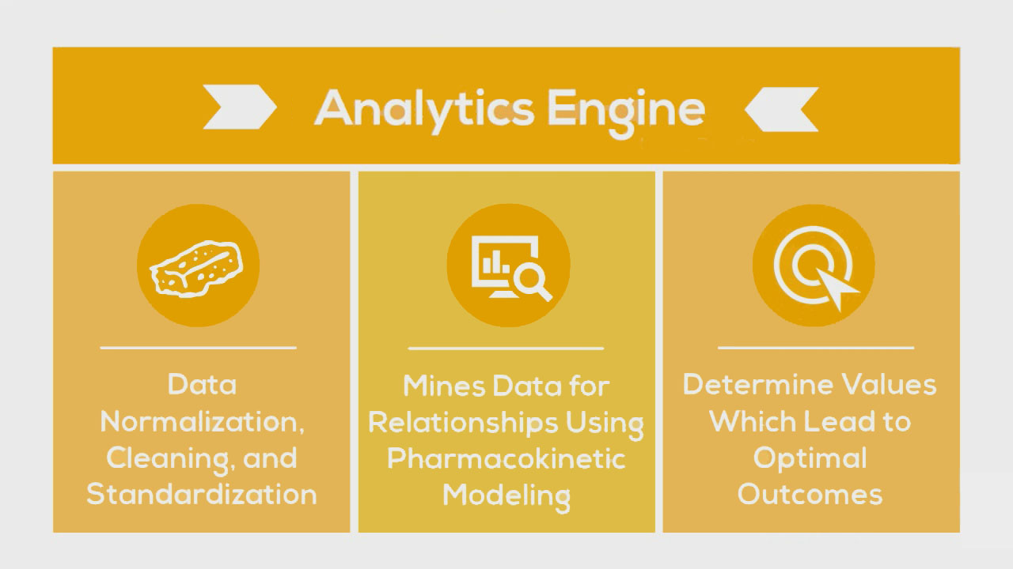
Data Analysis Plugins
Notes:
Change yellow background
Slow down here
Once we’ve accumulated all of this data, the QuantiModo Analytics Engine then clean the data and mines it using pharmacokinetic modeling techniques, which take into account onset delays and durations of action to determine which factors have the strongest influence on a given outcome and what the optimal daily values are.
e.g. Pizza -> might not notice effects until later that day or even gluten sensitivity until a few days later

Slide 20
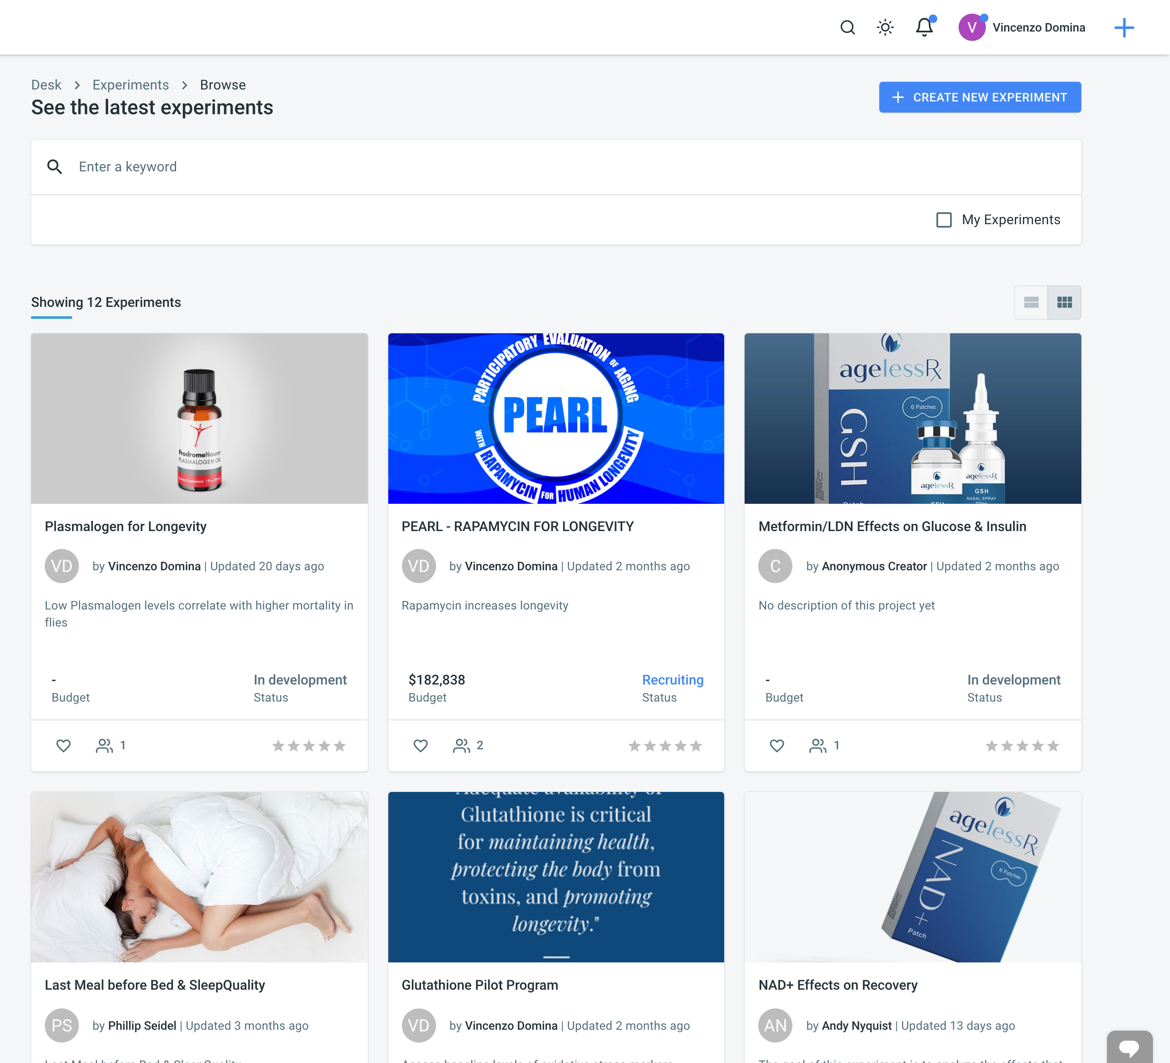
Open Cures Trial Management Plugin
CureDAO can be used to support decentralized clinical trials, which cost less and have a higher success rate than traditional ones.

Slide 21
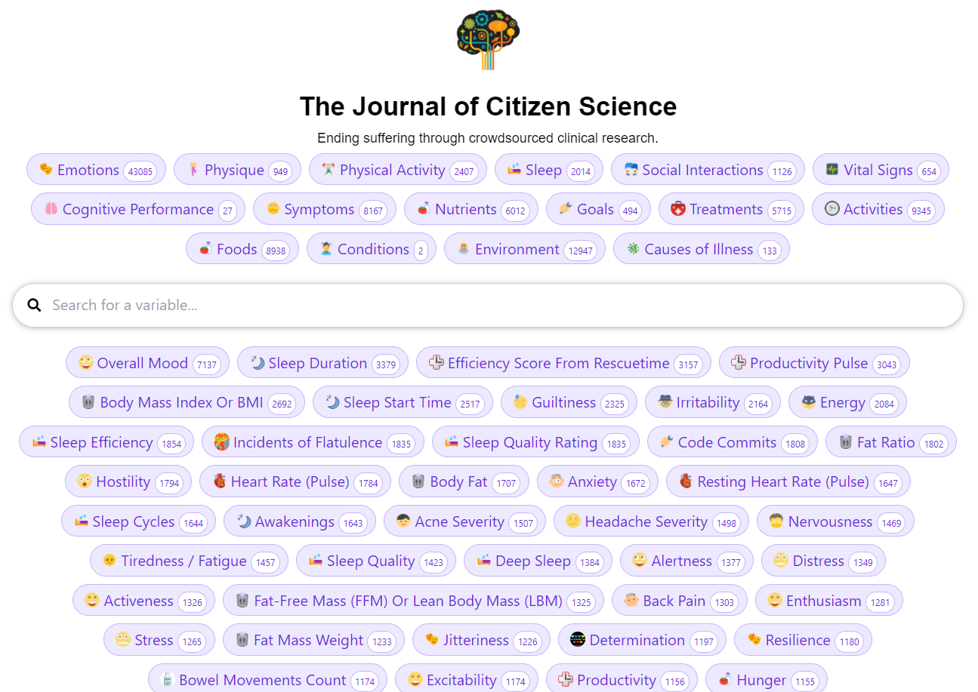
Study Generation Plugins
We’ve created 80,00 studies examining the effects of various factors on symptom severity

Slide 22
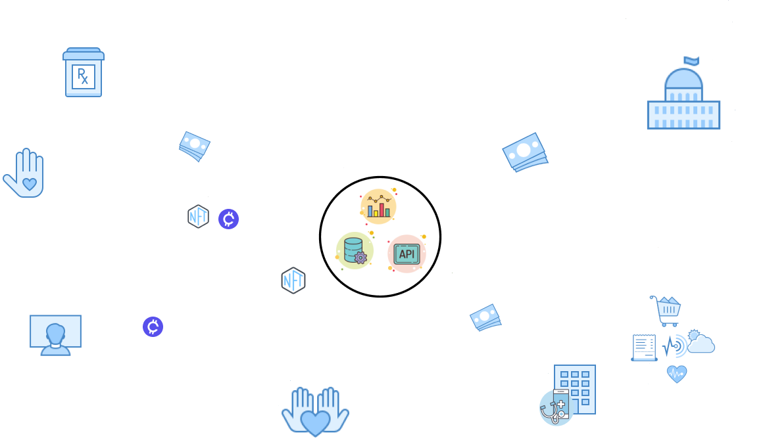

Slide 23
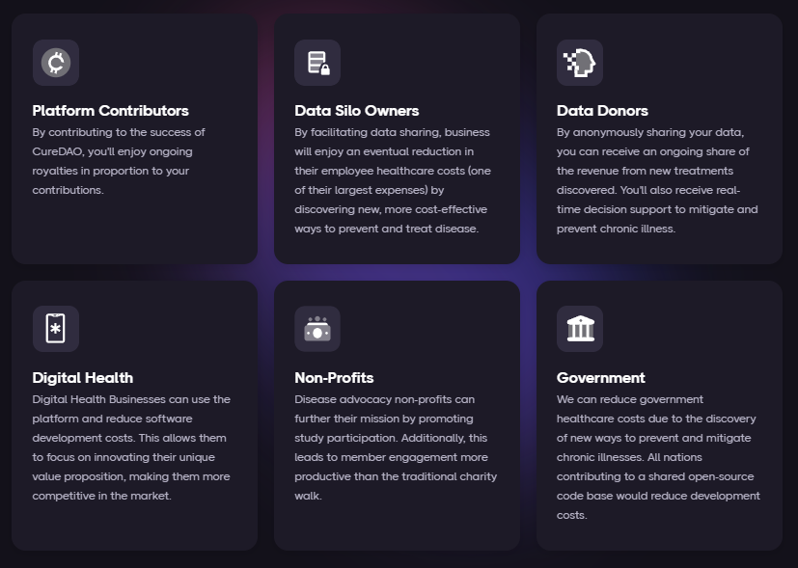
How Intelligent Voluntary Cooperation Makes Everyone Better Off

Slide 24
COMPETITORS
Collaborators
The most similar companies are
closed-source decentralized clinical trial companies like Medable
health data aggregators like Validic
However, our mission is to compete with no one and integrate with everyone.

Slide 25

Contributors

Slide 26
Collaborators

Slide 27
What We Have
TODO
API
Data Importers from Dozens of Sources
SDKs in 8 Languages
Data Collection Apps
Study Generation and Causal Inference
Clinical Trial Management
HIPAA Compliant Storage
No Code App Builder
Plugin Framework
GUI Data Mapper to Add New Data Import and Export Formats
Better Documentation of the SDKs and API
Developer Support for the Various Languages
Example integrations/projects in all languages
Partnerships with 350k Apps
Apply for SBIR and Other Grants and other fundraising
Reference Data Search and Wiki for the curation of variable data links/documentation
More data importers
Automate compensation
Establish a legal entity
Bounties for security issues and bugs
Federated learning, homomorphic encryption or decentralized data storage
Billing mechanism for charging tokens for usage

Slide 28
Roadmap
Plugin Framework
GUI Data Mapper to Add New Data Import and Export Formats
Better Documentation of the SDKs and API
Developer Support for the Various Languages
Example integrations/projects in all languages
Partnerships with 350k Apps
Apply for SBIR and Other Grants and other fundraising
Reference Data Search and Wiki for the curation of variable data links/documentation
More data importers
Automate compensation
Establish a legal entity
Bounties for security issues and bugs
Federated learning, homomorphic encryption, or decentralized data storage
Billing mechanism for charging tokens for usage

Slide 30

Thank you!
Join us at curedao.org!

Slide 31
Notes:
We're creating an open-source platform to determine the effects of every drug, food, and supplement on human health.

Slide 32
2 billion people suffer from inflammation-mediated diseases influenced by hundreds of unknown factors.

Slide 33
Due to the cost of research, we know almost nothing about anything that isn’t patentable.

Slide 34
Solution: Turn Oceans of Human Generated Data into Personalized Recommended Daily Allowances

Slide 35
Overcoming Challenges with Real-World Evidence and Inferring Causal Relationships
Predictive control model machine learning algorithms can systematically determine optimal treatment dosages based on measurements obtained under real-life conditions involving noise, disturbances, and uncertainty.

Slide 36
This enables Decision-Support Notifications with the most effective thing, you can do to minimize symptom severity

Slide 37
Outcome Labels
We’ve generated thousands of
because it’s more valuable to know the health effects of different foods and treatments than the amount of riboflavin

Slide 39
Unfortunately, most individual studies between a particular treatment and outcome only have a few participants.
We need more input.

Slide 40
Question: How can an unprecedented explosion in health data and innovation produce no measurable improvement?
+
=

Slide 41
Answer: Collaboration & Data Sharing
is Punished by the Market
We’re wasting $157 billion paying over 350,000 programmers to write the same code to implement the same basic functionality.
Horizontal Stagnation
Notes:
The free-rider problem and the tragedy of the commons punishes any individual company that open sources it’s code

Slide 42
Notes:
It's hard to make any progress when we're paying over 350,000 programmers to build the exact same basic functionalities.
By standing on each other's shoulders instead of duplicating work, we can potentially increase the rate of progress by 350,000 times.
WordPress is a great example of how tens of thousands of independent plugin developers benefit from using and contributing to a shared core open-source platform.

Slide 43
WordPress: A Model for Open-Source Success

Slide 44
How it Works
CureDAO utilizes the power of Intelligent Voluntary Cooperation and new technologies to drive down the cost of clinical research.

Slide 47
Data Collection Plugins
Back-end-
as-a-Service (BaaS) Functionality for Data Collection Apps
Notes:
First we developed mobile apps and browser extensions to make it incredibly easy to track your symptom severity in a fraction of a second using a unique popup interface.
Move circle
Remove browser
Screenshot of mood tracking screen

Slide 48
Importer Plugins
Notes:
Move information to left and images on the right.
We also built the QuantiModo Connector Framework, which enabled us to automatically pull passively or actively generated user data from dozens of applications and devices such as Fitbits, Withings scales and blood pressure monitors, and diet data from apps like MyFitnes
The QuantiModo Connector Framework pulls data from dozens of applications and devices such as Fitbits, Withings scales and blood pressure monitors, and diet data from apps like MyFitnessPal.
(Only show most popular ones with names and x more)

Slide 49
Data Analysis Plugins
Notes:
Change yellow background
Slow down here
Once we’ve accumulated all of this data, the QuantiModo Analytics Engine then clean the data and mines it using pharmacokinetic modeling techniques, which take into account onset delays and durations of action to determine which factors have the strongest influence on a given outcome and what the optimal daily values are.
e.g. Pizza -> might not notice effects until later that day or even gluten sensitivity until a few days later

Slide 50
Open Cures Trial Management Plugin
CureDAO can be used to support decentralized clinical trials, which cost less and have a higher success rate than traditional ones.

Slide 51
Study Generation Plugins
We’ve created 80,00 studies examining the effects of various factors on symptom severity

Slide 53
How Intelligent Voluntary Cooperation Makes Everyone Better Off

Slide 54
COMPETITORS
Collaborators
The most similar companies are
closed-source decentralized clinical trial companies like Medable
health data aggregators like Validic
However, our mission is to compete with no one and integrate with everyone.

Slide 55
Contributors

Slide 56
Collaborators

Slide 57
What We Have
TODO
API
Data Importers from Dozens of Sources
SDKs in 8 Languages
Data Collection Apps
Study Generation and Causal Inference
Clinical Trial Management
HIPAA Compliant Storage
No Code App Builder
Plugin Framework
GUI Data Mapper to Add New Data Import and Export Formats
Better Documentation of the SDKs and API
Developer Support for the Various Languages
Example integrations/projects in all languages
Partnerships with 350k Apps
Apply for SBIR and Other Grants and other fundraising
Reference Data Search and Wiki for the curation of variable data links/documentation
More data importers
Automate compensation
Establish a legal entity
Bounties for security issues and bugs
Federated learning, homomorphic encryption or decentralized data storage
Billing mechanism for charging tokens for usage

Slide 58
Roadmap
Plugin Framework
GUI Data Mapper to Add New Data Import and Export Formats
Better Documentation of the SDKs and API
Developer Support for the Various Languages
Example integrations/projects in all languages
Partnerships with 350k Apps
Apply for SBIR and Other Grants and other fundraising
Reference Data Search and Wiki for the curation of variable data links/documentation
More data importers
Automate compensation
Establish a legal entity
Bounties for security issues and bugs
Federated learning, homomorphic encryption, or decentralized data storage
Billing mechanism for charging tokens for usage

Slide 60
Thank you!
Join us at curedao.org!

Slide 61
REVENUE STREAMS
END USER SUBSCRIPTION
Freemium model - users install our mobile tracking apps with limited functionality for free
Pricing - Data aggregation and analysis features would require a $5/month subscription
Potential Market - 613 million potential customers would include those managing mood disorders, autoimmune diseases, or other trackable chronic illnesses
B2B DATA AGGREGATION AND ANALYSIS SaaS
Customers - We would allow any of the more than 268,747 application developers, researchers, and healthcare providers to utilize our platform’s data collection, integration and analysis capabilities.
Pricing - To be competitive with the current providers, we would charge $600 per month per 5000 end users.

Slide 62
REVENUE STREAMS
END USER SUBSCRIPTION
Freemium model - users install our mobile tracking apps with limited functionality for free
Pricing - Data aggregation and analysis features would require a $5/month subscription
Potential Market - 613 million potential customers would include those managing mood disorders, autoimmune diseases, or other trackable chronic illnesses
B2B DATA AGGREGATION AND ANALYSIS SaaS
Customers - We would allow any of the more than 268,747 application developers, researchers, and healthcare providers to utilize our platform’s data collection, integration, and analysis capabilities.
Pricing - To be competitive with the current providers, we would charge $600 per month per 5000 end users.

Slide 63







CUSTOMER SEGMENTS
Researchers
Patients
Health Apps
It currently costs $48k per subject in a phase 3 clinical trial. Instead of spending months gathering data, 7 million researchers can create a shareable URL that they can share with participants to authorize access to pre-existing data in quantities never seen before.
1.3 billion people managing chronic illnesses can user our client apps and browser extensions, patients can easily track their symptoms, import data from other sources, and discover hidden dietary, behavioral, and environmental factors that could be exacerbating or improving their symptoms.
There are 97,000 health apps which can save months of development time and tens of thousands of dollars by using our platform instead of reinventing the wheel.
Health Insurers
Healthcare Providers
Pharmaceutical Companies
Health plan providers need a more personalized approach to help their members and have found a way to do so with provider-and patient-reported digital health data. By incorporating this data into a centralized repository, payers can analyze and use this information to create and improve their various member services.
QuantiModo’s treatment and symptom tracking application would reduce the number of deaths and costs of intervention by alerting patients and their practitioners to conditions before they become irreversible. Additionally, the opportunity to meet and promote these applications to physicians would also serve as a novel new way for pharmaceutical manufacturers to connect with physicians.
8 million healthcare providers could tremendously benefit from our dashboard visualizing all factors in a patient’s health can then help doctors formulate an informed care plan.
Notes:
Cut to less than
Faster (see tape)
Should be at 6:00 here
Limit to
Leave numbers out of dictation
Introduce Renato – 1:45
Who Will Pay, 6 segments
Developers
There are 97,000 health apps which can save months of development time and tens of thousands of dollars by using our platform instead of reinventing the wheel.
Researchers
It currently costs $48k per subject in a phase 3 clinical trial. Instead of spending months gathering data, 7 million researchers can create a shareable url that researchers can share with participants to authorize access to pre-existing data in quantities never seen before.
Patients
1.3 billion people managing chronic illnesses can user our client apps and browser extensions, patients can easily track their symptoms, import data from other sources, and discover hidden dietary, behavioral, and environmental factors that could be exacerbating or improving their symptoms.
Health Insurers
Furthermore, this new digital health solution would help to drive down cost for insurance providers. Health plan providers need a more personalized approach to help their members and have found a way to do so with provider-and patient-reported digital health data. By incorporating this data into a centralized repository, payers can analyze and use this information to create and improve their various member services. For example, in addition to supporting patient-specific care-management models, integrated data could enable the creation of wellness programs, preventive or disease-management care initiatives or even health-coaching programs. This personalized data can go beyond incentivizing and motivating healthy lifestyles; it can also help payers increase member engagement, a critical objective for many health plan providers.
Pharmaceutical Companies
106,000 people die annually in the U.S. from properly prescribed drugs. The number of people having in-hospital, adverse reactions to prescribed drugs to be 2.2 million per year. The total number of deaths caused by conventional medicine is 783,936 per year. Pharmaceutical companies spend over $2 billion a year on over 314,000 events attended by doctors.
Initial sponsor applications will be focused on tracking adverse reactions to the medications known to produce the most adverse reactions. MEDTLC, QuantiModo’s treatment and symptom tracking application would reduce the number of deaths and costs of intervention by alerting patients and their practitioners to conditions before they become irreversible. Additionally, the opportunity to meet and promote these applications to physicians would also serve as a novel new way for pharmaceutical manufacturers to connect with physicians.
Healthcare Providers
A dashboard visualizing all factors in a patient’s health can then help doctors formulate an informed care plan.

Slide 64

BUSINESS VALIDATION
Validic has received over $12 million in investment this year
Human API has received $6 million in new investment this year
Continued >50% CAGR projected in digital health space

Slide 65
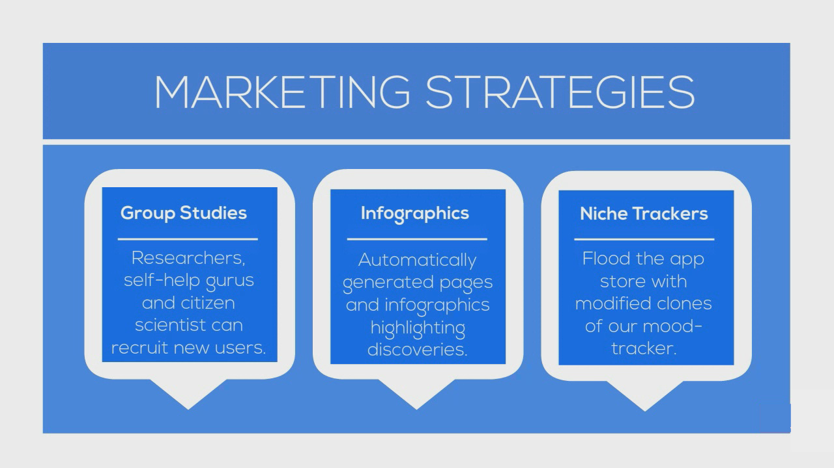

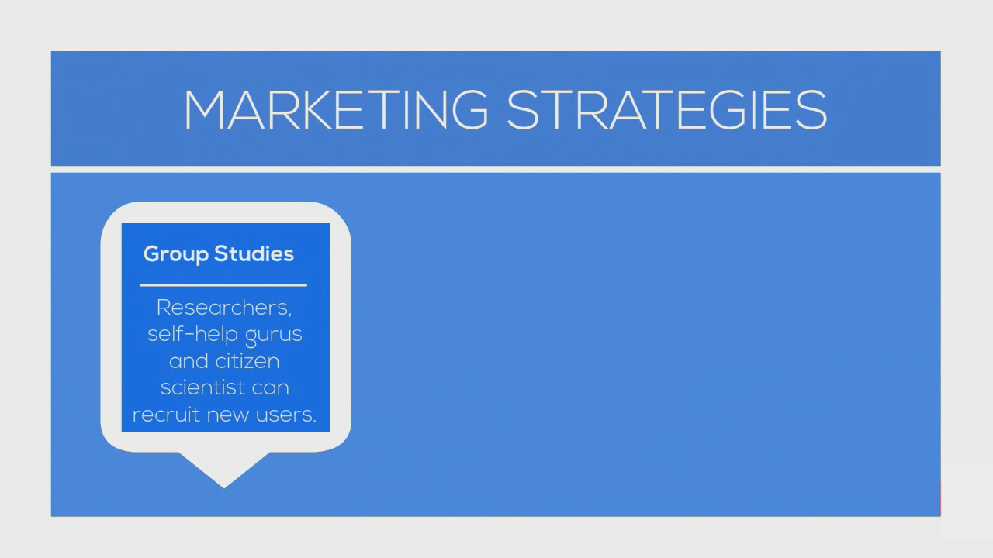
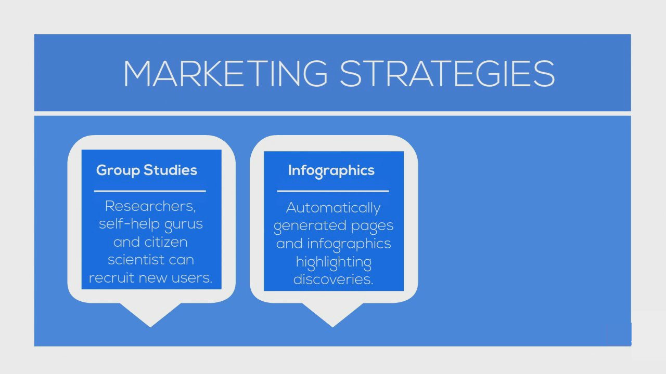
PRIMARY MARKET (SaaS)
268,747 Potential Customers
97,000 Health and Fitness Applications
165 Pharmaceutical Companies
171,582 Hospitals
Notes:
*provide them with a platform for recruiting new users, storing their data, and analyzing it. So they can do what currently takes months in a matter of hours.

Slide 66
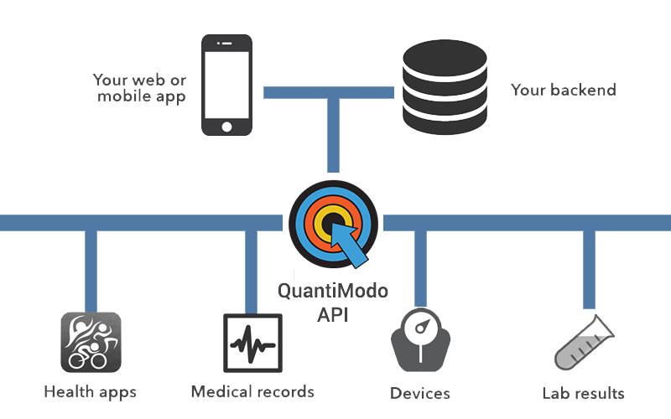


Developer Platform
Notes:
QuantiModo has been contacted by several website and app developers such as Healclick.com and SoundMindZ.com. These companies need connectors to pull in data and the statistical power to mine and derive insights from theses data. QuantiModo will provide this service without increasing operating costs while gaining actionable data and exposure.
By supplying an Application Programming Interface that is easy to use, conforms to established industry guidelines for information and security, as well as supplying App templates for users to use in building applications, QuantiModo will enable an accessible monetization platform for application writers, furthering the acceptance of QuantiModo’s model and boosting the user base numbers. We have developed Android and JavaScript software development kits (SDK’s) to allow any developer to easily implement QuantiModo support into any other application.

Slide 67
Total Addressable Market
613 Million People Track a Health Indicator
x $3 /user/year
= $1.8 Billion TAM
Notes:
We have 6 different segments with 6 different pricing models…
The digital health space has been growing with a massive 50% compound annual growth rate. The healthcare analytics market is a $30 billion dollar industry and includes remote patient monitoring, telehealth, and behavior modification technologies.
Given that Validic and the Human API are already charging about $4 or $5 per year per user. So we believe that $3 per year per user is a competitive price point for us.
613 million people are tracking a health indicator.
$3 per individual per year produces a $1.8 billion dollar total addressable market for QuantiModo.

